Slide 1

What is Software Quality: Part 1
CSE 464 : Software Quality Assurance and Testing
Janaka Balasooriya

Slide 2
Lecture Objective : Understand Software Quality
What is software quality?: A Closer Look

Slide 3
What is Software Engineering?
Quality: Conformance to explicitly stated functional and performance requirements, explicitly documented development standards, and implicit characteristics that are expected of all professionally developed software.
Process Model: Defines a framework that uses software engineering methods to build quality software.
Methods: technical details about how to’s for building software.
Tools: Provides automated or semi-automated support for methods and process

Slide 4
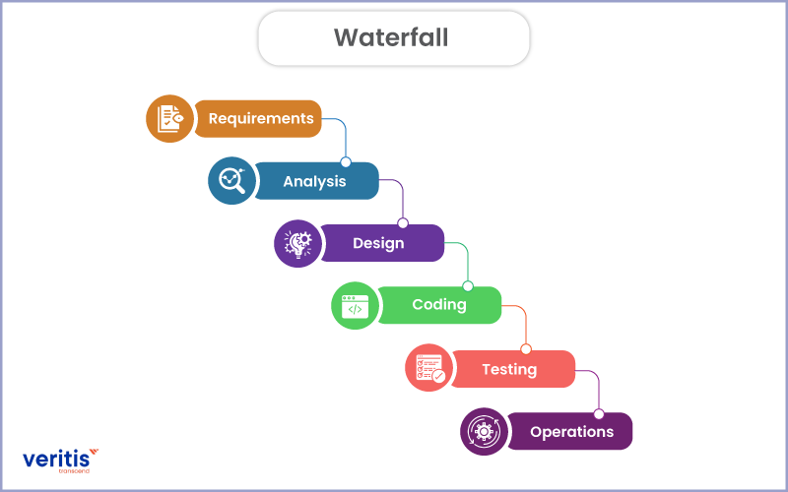
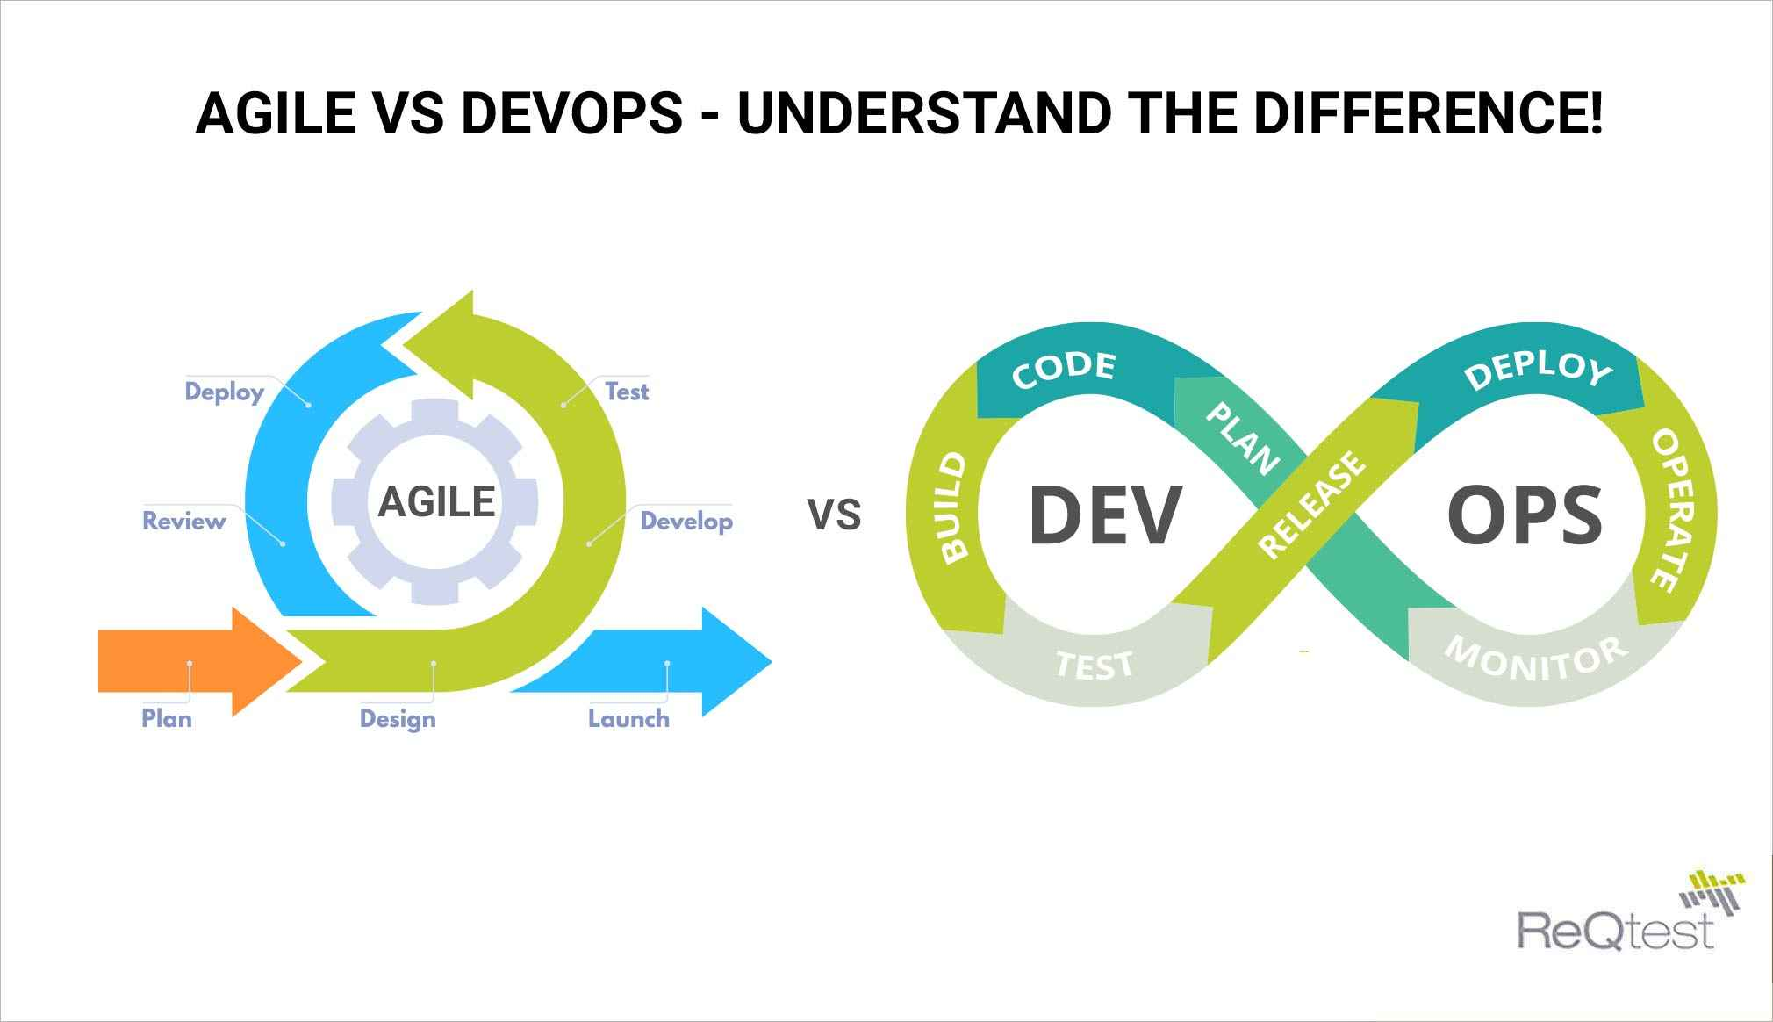
Process Models
https://www.veritis.com/blog/waterfall-vs-agile-vs-devops-which-production-method-should-you-take/
https://reqtest.com/agile-blog/agile-vs-devops/

Slide 5


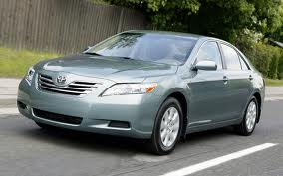
What is Software Quality?
Answer to this question depends on whom you ask the question, under what circumstance, for what kind of software systems …so on.
Different stake-holders of the software system are looking for different quality factors.
How do You Compare the Quality of These Cars?

Slide 6

Watts S. Humphrey’s View of Better Software
Good software, in Humphrey’s view, “is usable, reliable, defect free, cost effective and maintainable and software now is none of those things.
You can’t take something out of the box and know it’s going to work.”
Many consider him as the "father of software quality."

Slide 7
Software Quality Frameworks
ISO-9126 => ISO 25010 (most recent)
SEI- CMM
McCall’s Quality Factors
…. Many more

Slide 8
ISO – 25010 - Old
Functionality : Satisfy stated/implemented needs
Security : Safeguard against malicious, incidental attacks as well as prevent lost of theft of information
Compatibility : Ability to exchange information with other products, component, and systems
Portability : Cross platform compatibility
Reliability:
Capability to maintain its desired level of performance as required
Software
Quality
Maintainability : How easy it is to modify and test the software
Usability: How easy it is to understand, learn, and use the software
https://iso25000.com/index.php/en/iso-25000-standards/iso-25010
Efficiency : Level of performance and resources usage

Slide 9
ISO 25010 - New
Functionality : Satisfy stated/implemented needs
Security : Safeguard against malicious, incidental attacks as well as prevent lost of theft of information
Compatibility : Ability to exchange information with other products, component, and systems
Reliability:
Capability to maintain its desired level of performance as required
Safety : Degree to which a product under defined conditions to avoid human life, health or environment endangerment
Software
Quality
Interaction Capability: Degree to which a system can be interacted with by specified users
Maintainability : How easy it is to modify and test the software
Efficiency : Level of performance and resources usage
Flexibility : Degree to which a product can be adapted to changes
https://iso25000.com/index.php/en/iso-25000-standards/iso-25010

Slide 10
Next => Software Quality – Online Shopping Store Example

